Slide 1



NAIOP CHICAGO WEBINAR
2021 REAL ESTATE FORECAST
Guest Speaker
MARK J. EPPLI
Director & Faculty Associate,
James A. Graaskamp Center
University of Wisconsin-Madison
For Technical Assistance: Please call 773-472-3072 or email info@naiopchicago.org

Slide 2


The Covid Pandemic/Recession (and politics)

Slide 3
The Covid recession . . . .
Most recessions begin with rising interest rates/financial market stress undercutting demand for goods and services, driving up unemployment, which further crimps demand.
The Covid recession began with a natural disaster, like a hurricane, which interrupts the supply of and demand for goods and services. When a natural disaster ends, a V-shaped recovery ensues.
For the Covid recession, there was a partial V-shaped recovery in the third quarter as lockdowns were lifted. However, the pandemic is not under control.
Federal stimulus amplifies a V-shaped recovery
In recovery, investors price in higher interest rates. The Fed short-circuited that process promising that interest rates will stay near zero until inflation reaches 2% and unemployment falls to pre-pandemic levels.
As restrictions are lifted and confidence builds, consumer and capital spending will robustly return.
Source: Wall Street Journal, December 24, 2020, p. A2.

Slide 4
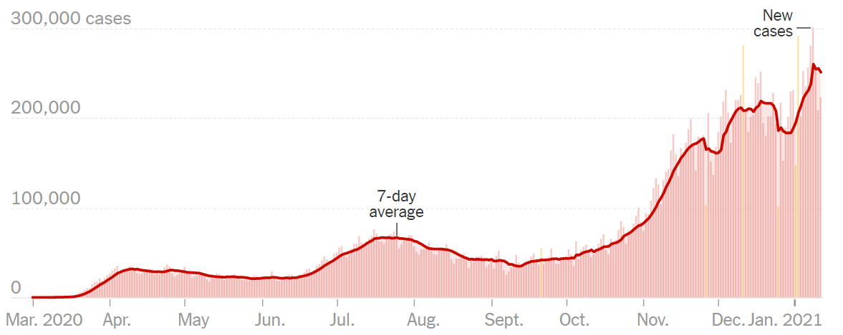
. . . . Corona virus cases are peaking . . . .
New Daily Corona Virus Cases in the United States
Source: New York Times webpage, January 12, 2021.

Slide 5

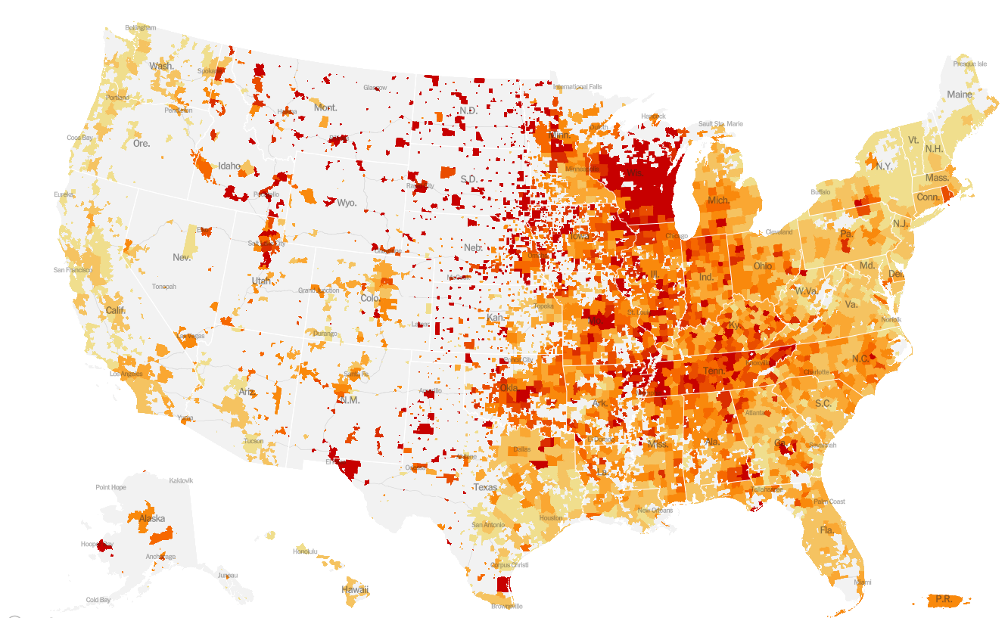
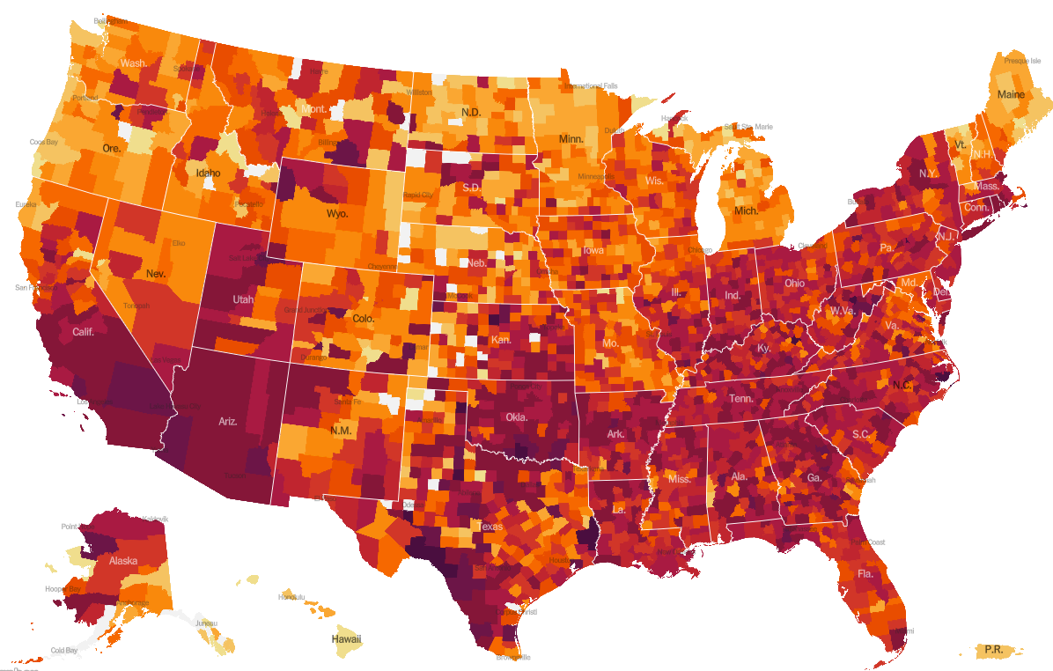
. . . . with cases spreading throughout the U.S. (red = high). . . .
New Daily Corona Virus Cases October 25, 2020
New Daily Corona Virus Cases January 12, 2021
Source: New York Times webpage, updated October 25, 2020
and January 12, 2021.

Slide 6
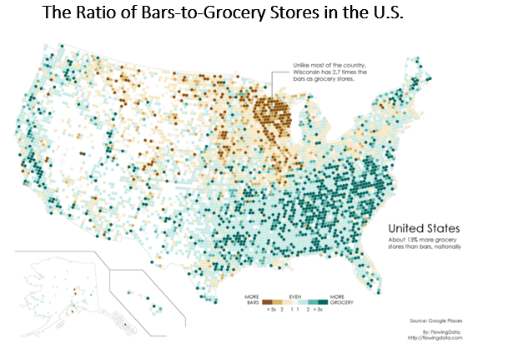
. . . . Covid relief or Covid super-spreader????
Source: FlowingData.com webpage at:
https://flowingdata.com/2014/05/29/bars-versus-grocery-stores-around-the-world/

Slide 7
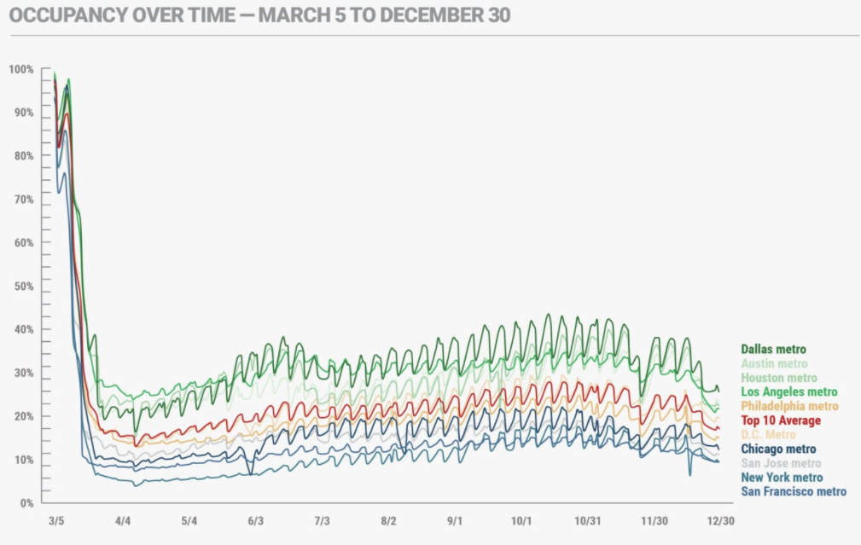
. . . . slowing the move back to work in the office.
Source: Kastle Systems webpage at:
https://www.kastle.com/city-by-city-views-of-americas-office-use/

Slide 8
Does presidential administration impact GDP?
Source: Federal Reserve Economic Data and Graaskamp Center.

Slide 9
Back to Basics
Value = NOI/Cap Rate
Value = RE Property Markets/RE Capital Markets
Value = Fiscal Stimulus/Monetary Stimulus

Slide 10
Fiscal Stimulus – Impacts on Income, Employment/Business, and Consumption

Slide 11
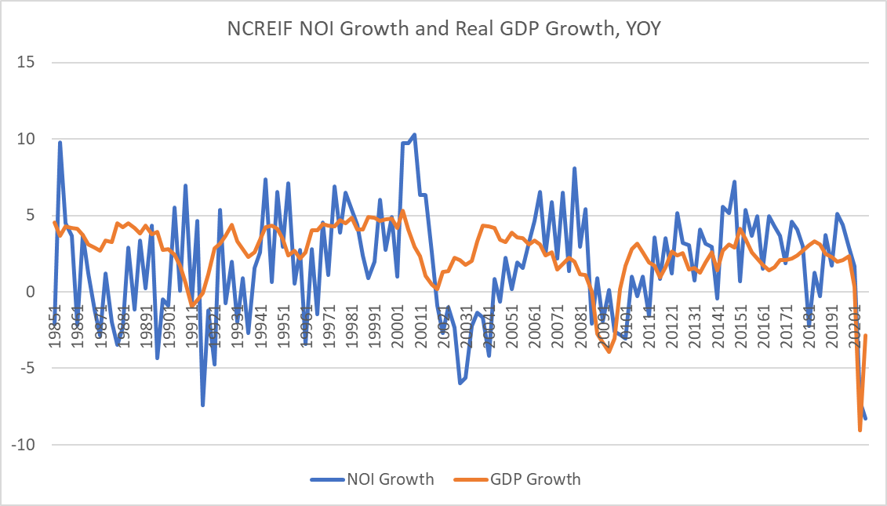
Why fiscal stimulus is important, it impacts and leads NOI . . . .
Source: NCRIEF, Federal Reserve Economic
Data, and Graaskamp Center.

Slide 12
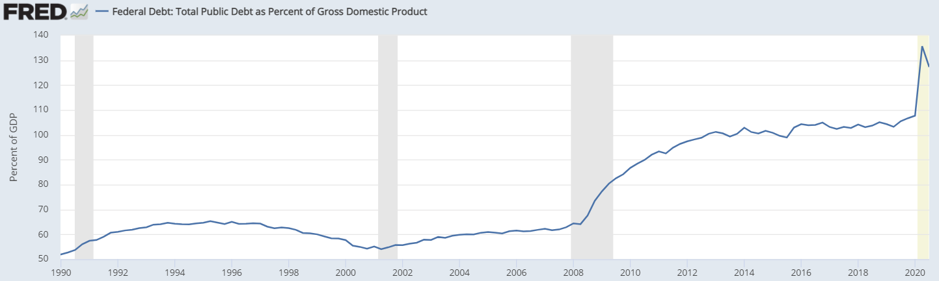
. . . . 2020 saw significant deficit spending and Covid relief . . . .
Source: Bloomberg and Graaskamp Center.

Slide 13
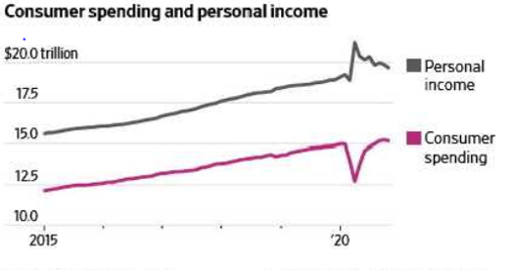
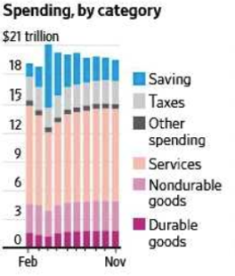
. . . . fiscal stimulus boosted personal income and revived consumer spending . . .
Source: Wall Street Journal, December 24, 2020, p. A2.

Slide 14
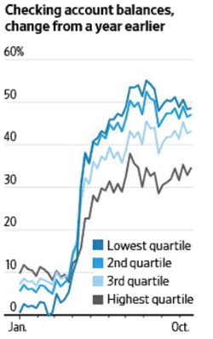
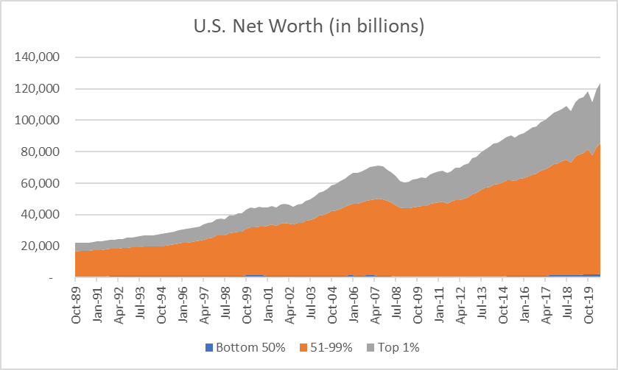
. . . . stimulus savings positively impacted checking account balances across income levels however wealth is unevenly distributed.
Source: Wall Street Journal, December 31, 2020, p. A2,
and Federal Reserve Economic Data and Graaskamp Center.

Slide 15
Fiscal Stimulus – Employment Impacts

Slide 16
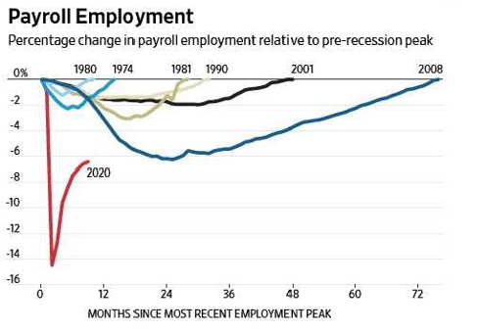
The path back to full employment, what shape will it take . . . .
Source: Wall Street Journal, December 17, 2020, p. A2.

Slide 17
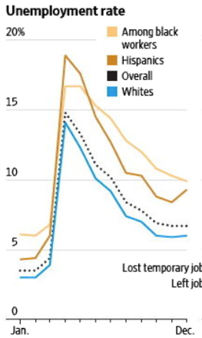
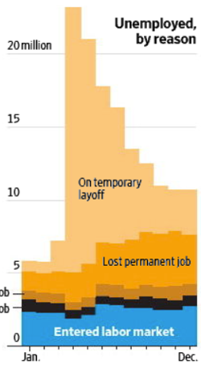
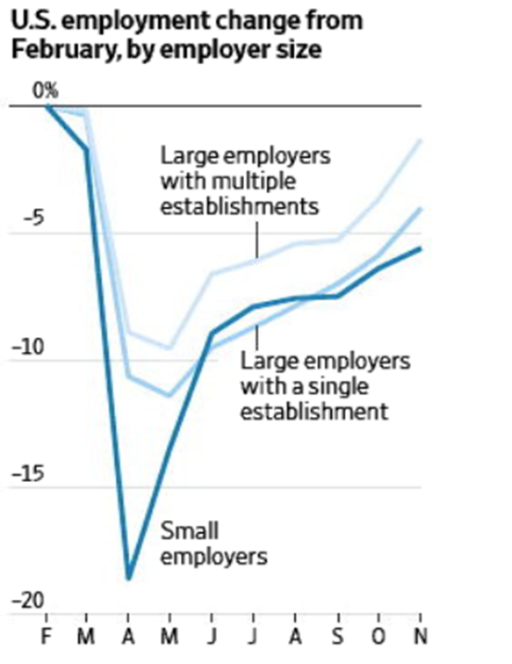
. . . . the uneven impact of the Covid recession on employment . . . .
Source: Wall Street Journal, January 9, 2021, p. A2
and December 20, 2020, p. B6.

Slide 18
. . . . the uneven impact of the Covid recession echoed. . . .
Source: Bureau of Labor Statistics and Graaskamp Center.

Slide 19
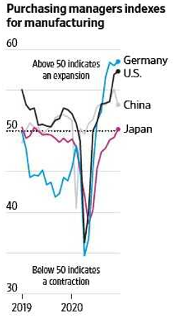
. . . . manufacturers are bullish.
Source: Wall Street Journal, January 5, 2021, p. A2.

Slide 20
Fiscal Stimulus – Consumer Spending Impacts

Slide 21
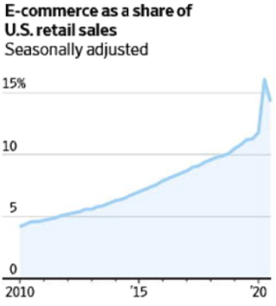
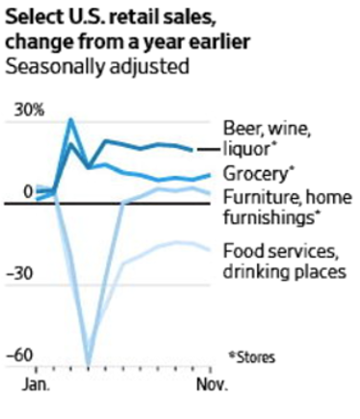
Places of retail activity shifted during Covid. . . .
Source: Wall Street Journal, December 20, 2020, p. .B6

Slide 22
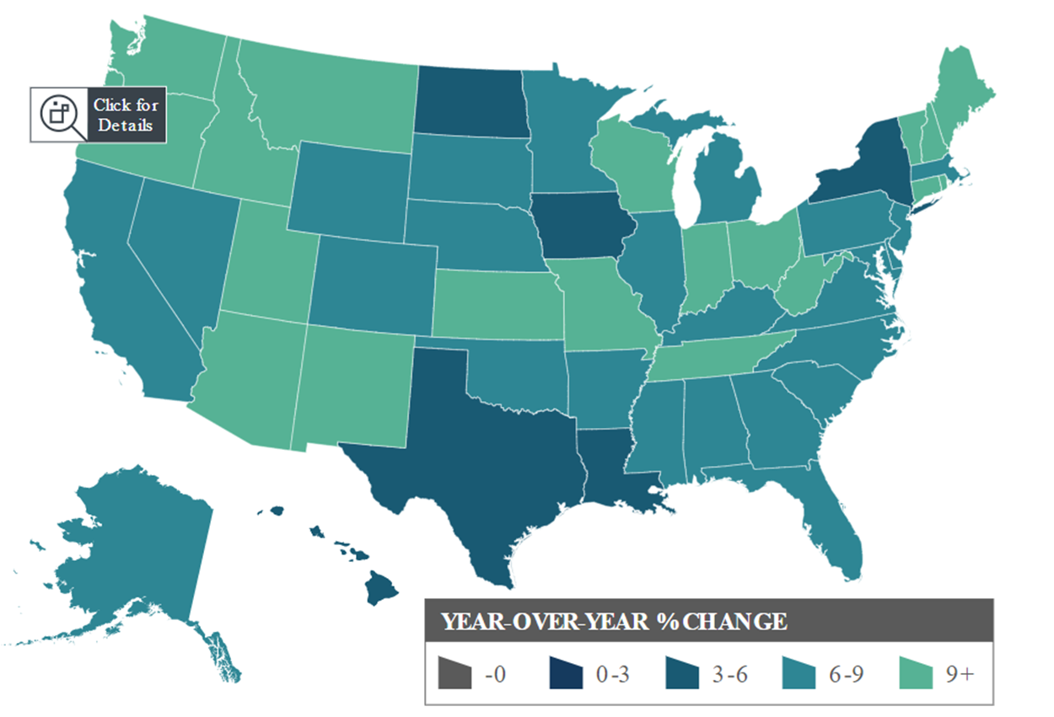
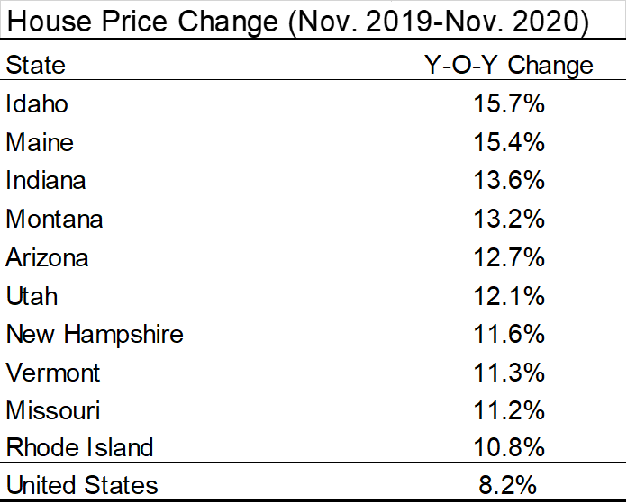
. . . . with strong demand for single-family homes – but note where. . . .
Source: CoreLogic, “U.S. House Price Insights,” November 2020.

Slide 23
(tangent alert!) . . . but do not rule out the return to the city.
Cities are places of consumption:
  Where we are entertained – sports, theatre, music
  Where a diversity of food is offered
  Where people find a partner
Cities are places of production and innovation:
  Where residents of U.S. cities of over one million are 50% more productive than smaller MSAs
  Where firms cluster to seek top-notch talent
  Where employees seek top-notch firms
  Where firms innovate (think Amazon’s HQ2, 238 submissions, and 54 states and territories)
The richness of face-to-face experiences and interactions in cities can not be replaced by technology.

Slide 24
Monetary Stimulus

Slide 25
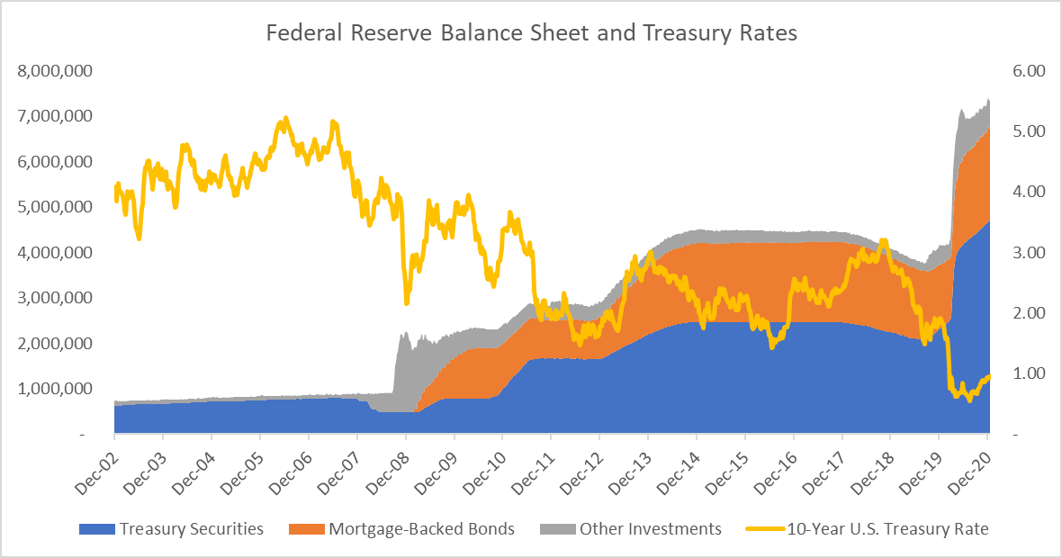
Monetary stimulus can impact on long-term Treasury rates . . . .
Source: Federal Reserve Economic Data, and
Graaskamp Center.

Slide 26
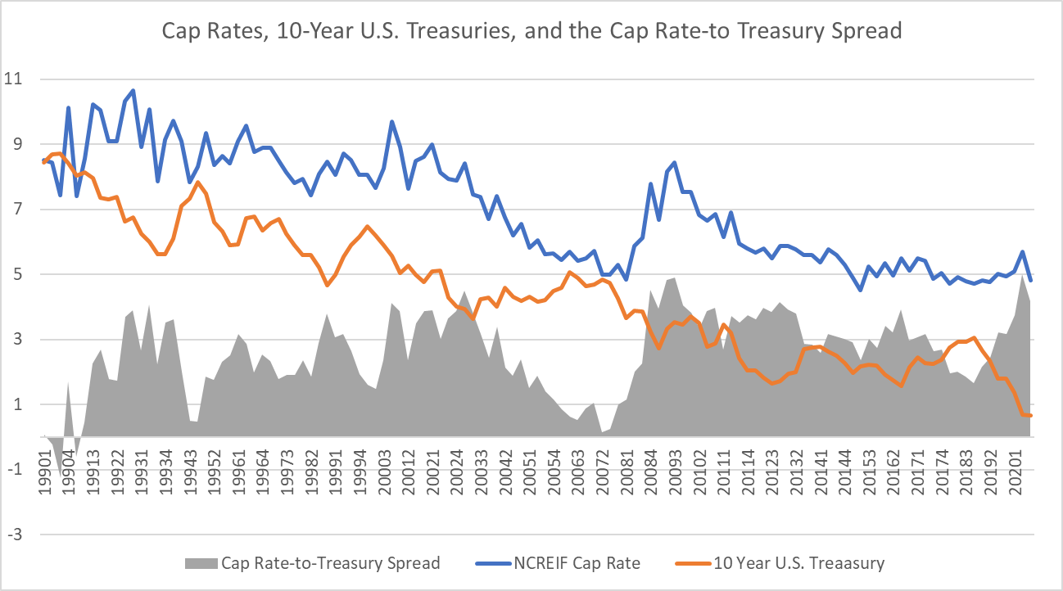
. . . . and long-term U.S. Treasury rates impact cap rates. . . .
Source: NCREIF, Federal Reserve Economic Data, and
Graaskamp Center.

Slide 27
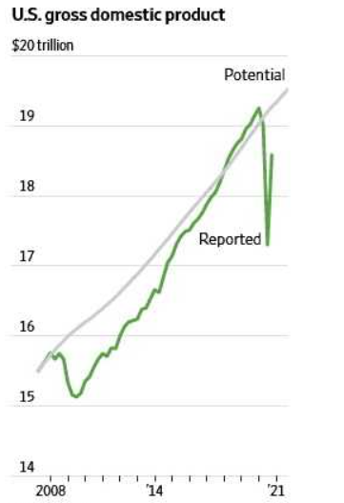
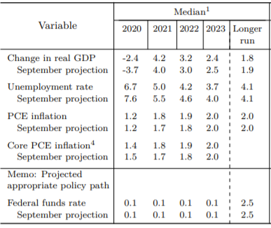
. . . . the Federal Reserve’s summary of economic projections.
Source: Fedaeral Reserve, “Summary of Economic Projections.”
December 20, 2020 and Wall Street Journal, January 12, 2021, p. B12.

Slide 28
Capital Markets – Equity and Debt

Slide 29
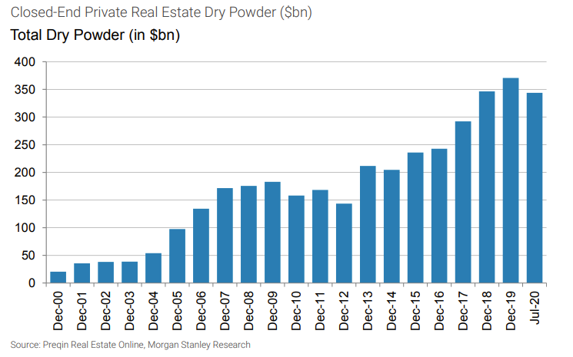
Equity capital awaits opportunity. . . .
Source: Morgan Stanley Research, The State of the Real
Estate Cycle, 7th Edition, October 5, 2020.

Slide 30
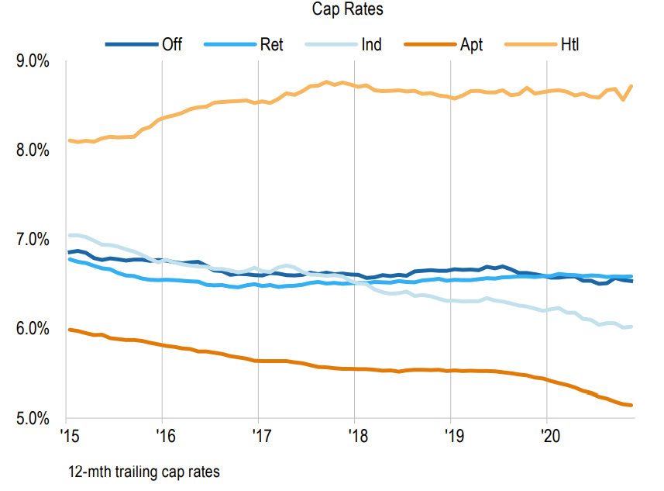
. . . . cap rates are following different paths by property type. . . .
Source: Real Capital Analytics, “Capital Trends: U.S.
Big Picture,” November 2020.

Slide 31
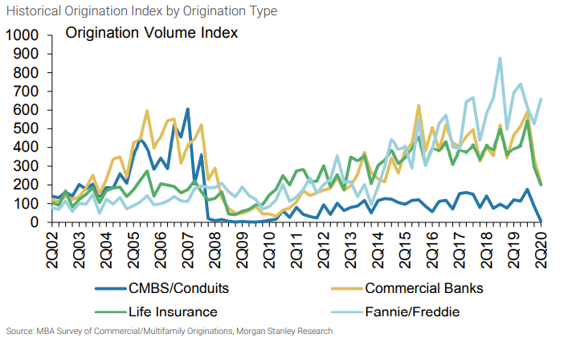
Net new origination volumes (other than Freddie and Fannie) are falling . . . .
Source: Morgan Stanley Research, The State of the Real
Estate Cycle, 7th Edition, October 5, 2020.

Slide 32
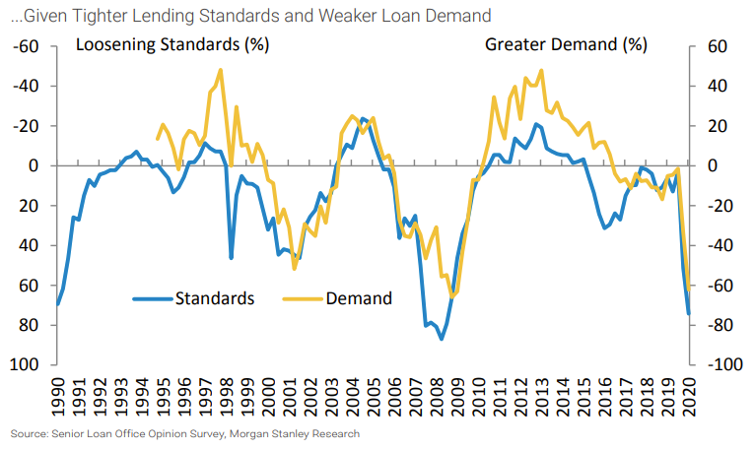
. . . . as bank lending standards are tighten and fewer loans are demanded . . . .
Source: Morgan Stanley Research, The State of the Real
Estate Cycle, 7th Edition, October 5, 2020.

Slide 33
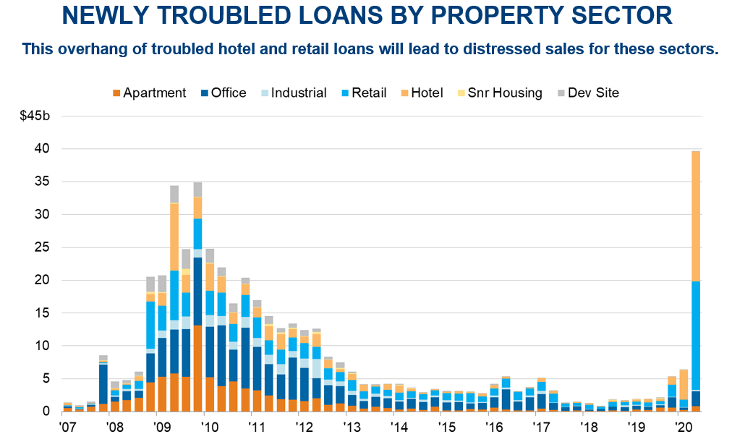
. . . . and risk of loss increases – for some property types.
Source: James Costello, Real Capital Analytics presentation
To the Graaskamp Leadership Service, November 18, 2020.

Slide 34
Property Markets

Slide 35
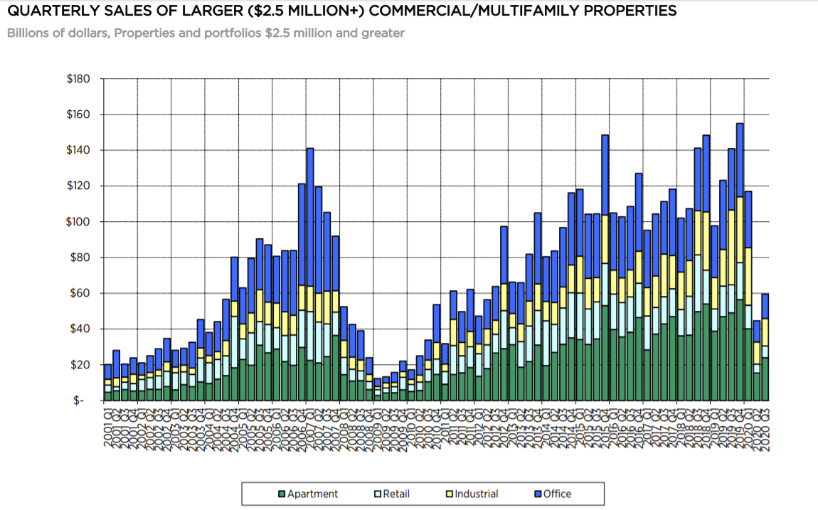
Transaction volume is down 57% YOY. . . .
Source: MBA, “Commercial/Multifamily Quarterly
Databook, Q3 2020.

Slide 36
. . . .transaction volume follows sector-level GDP growth . . . .
Source: Real Capital Analytics, “Capital Trends:
U.S. Big Picture,” November 2020.

Slide 37
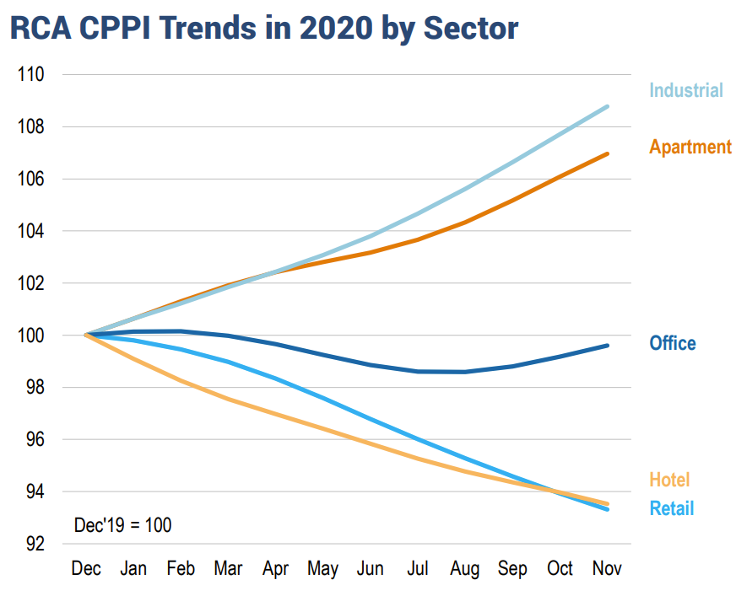
. . . . with the property-types following a K-shaped recovery – which way will office go. . . .
Source: Real Capital Analytics, “Capital Trends: U.S.
Big Picture, Novemberr 2020.

Slide 38
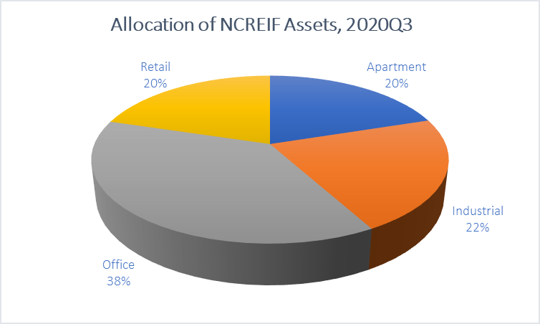
. . . . with concern about office fundamentals around work from home and an over allocation to office, expect weak investor demand for the property type.. . . .
Source: NCREIF, Federal Reserve Economic Data, and
Graaskamp Center.

Slide 39
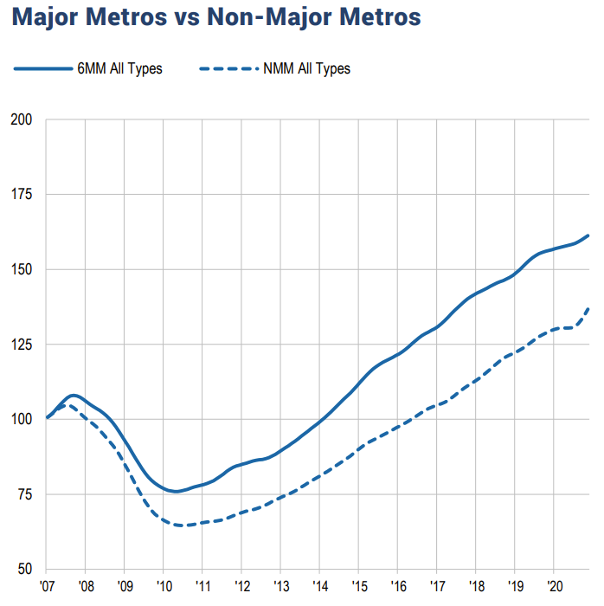
. . . . smaller metro commercial property markets are outperforming. . . .
Source: Real Capital Analytics, “RCA, Commercial
Property Price Indices,” November 2020.

Slide 40
Summary and trends for 2021
1. The Covid recession is not driven by the same factors as a financial recession
A. Capital markets are not the driver of the downturn and are largely healthy
B. Should be a V-shaped downturn (think 9-11 impacts) but Covid comes with a tail
C. Identify and separate cyclical behaviors from structural shifts
2. GDP/job growth will struggle in 2021Q1-Q2, but pent-up demand will jump start 2021Q3-Q4
A. Travel, restaurant, and related services will be slow to return
B. Many firms and households have ready capital to spend/invest
C. Many firms lost capacity, we wary of inflation hot spots
D. Do not write-off large metropolitan areas
Expect a K-shaped real estate property and capital market recovery
A. Capital will flow to industrial and apartment assets keeping cap rates and returns low
B. Opportunities will be found in hospitality – timing matters
C. Consider next space users and exit strategy purchasers for office and retail

Slide 41

It was a solid 5 days. Here’s to 2022!

Slide 42
NAIOP CHICAGO WEBINAR
2021 REAL ESTATE FORECAST
Guest Speaker
MARK J. EPPLI
Director & Faculty Associate,
James A. Graaskamp Center
University of Wisconsin-Madison
For Technical Assistance: Please call 773-472-3072 or email info@naiopchicago.org

